Slide 1

PREDICTING HOUSE PRICE USING MACHINE LEARNING
PROJECT : HOUSE PRICE PREDICTION

Slide 2

Introduction:
Ask a home buyer to describe their dream house, and they probably won’t begin with the height of the basement ceiling or the proximity to an east-west railroad.
But this playground competition’s dataset proves that much more influences price negotiations than the number of bedrooms or a white-picket fence.
With 79 explanatory variables describing (almost) every aspect of residential homes in Ames, Iowa, this competition challenges you to predict the final price of each home.

Slide 3
Content for a Project Phase 2:
Consider exploring advanced regression techniques like Gradient Boosting or XGBoost for improved Prediction accuracy.
Data Source:
A good data source for house prediction using machine learning should be
Accurate,Complete,Covering the geographie area of interest,Accessible.
Data Link:(https://www.kaggle.com/datasets/vedavyasv/usa-housing)

Slide 5

Advanced Regression Techniques:
Ridge Regression:Introduce L2 regularization to mitigate multicollinearity and overfitting.
Lasso Regression:Employ L1 regularization to perform selection and simplify the model
ElasticNet regression:combine both L1and L2 regularization to benefit from their respective advantages.
Random forest regression:implement an ensemble technique to handle non-linearity and capture complex relationship in the data
Gradient boosting regressors(eg.XGBoost,LightGBM):
Utilize gradient boosting algorithms for improved accuracy.

Slide 6
Program:
import pandas as pd
import numpy as np
import seaborn as sns
import matplotlib.pyplot as plt
from sklearn.model_selection import train_test_split
from sklearn.preprocessing import StandardScaler
from sklearn.metrics import r2_score, mean_absolute_error,mean_squared_error
from sklearn.linear_model import LinearRegression
from sklearn.linear_model import Lasso
from sklearn.ensemble import RandomForestRegressor
from sklearn.svm import SVR
import xgboost as xg
%matplotlib inline
import warnings
warnings.filterwarnings("ignore")
/opt/conda/lib/python3.10/site-packages/scipy/__init__.py:146: UserWarning: A NumPy version >=1.16.5 and <1.23.0 is required for this version of SciPy (detected version 1.23.5 warnings.warn(f"A NumPy version >={np_minversion} and <{np_maxversion}"
Loading Dataset
In [2]:
dataset = pd.read_csv('/kaggle/input/usa-housing/USA_Housing.csv')

Slide 7
Model 1 - Linear Regression
IN[1]:
model_lr=LinearRegression()
IN[2]:
model_lr.fit(X_train_scal, Y_train)
OUT[2]:
LinearRegression
LinearRegression()
Predicting Prices
Prediction1 = model_lr.predict(X_test_scal)
Evaluation of Predicted Data
plt.figure(figsize=(12,6))
plt.plot(np.arange(Y_test)), Y_test, label='Actual Trend')
plt.plot(np.arange(Y_test)), Prediction1, label='Predicted Trend')
plt.xlabel('Data')

Slide 8
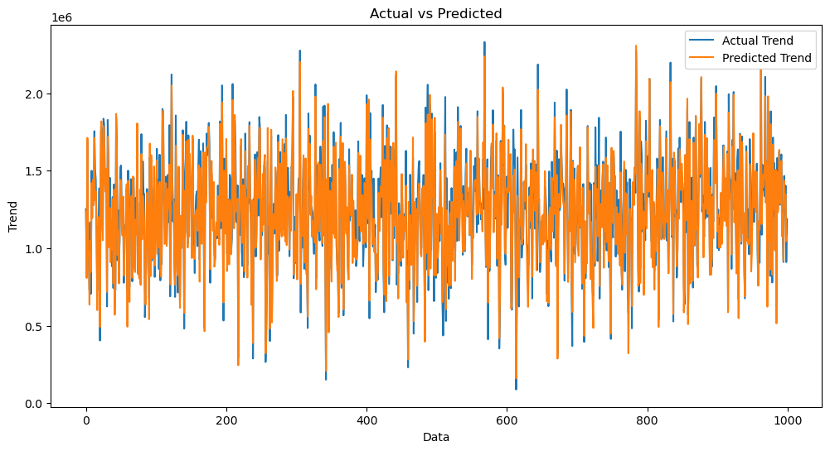
Output:
Text(0.5, 1.0, 'Actual vs Predicted')
IN[5]:
sns.histplot((Y_test-Prediction1), bins=50)
OUT[5]:
<Axes: xlabel='Price', ylabel='Count'>

Slide 9
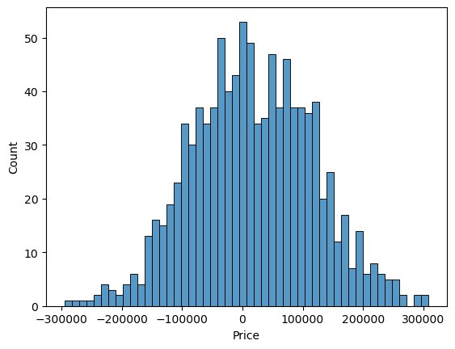
IN[6]
print(r2_score(Y_test, Prediction1))
print(mean_absolute_error(Y_test, Prediction1))
print(mean_squared_error(Y_test, Prediction1))
OUT[6]:
0.9182928179392918
82295.49779231755
10469084772.975954

Slide 10
Model 2 - Support Vector Regressor
IN[7]:
model_svr = SVR()
IN[8]:
model_svr.fit(X_train_scal, Y_train)
OUT[8]:
SVR
SVR()
Predicting Prices
IN[9]:
Prediction2 = model_svr.predict(X_test_scal)
Evaluation of Predicted Data
IN[10]:
plt.figure(figsize=(12,6))
plt.plot(np.arange(len(Y_test)),Y_test,label='ActualTrend')

Slide 11
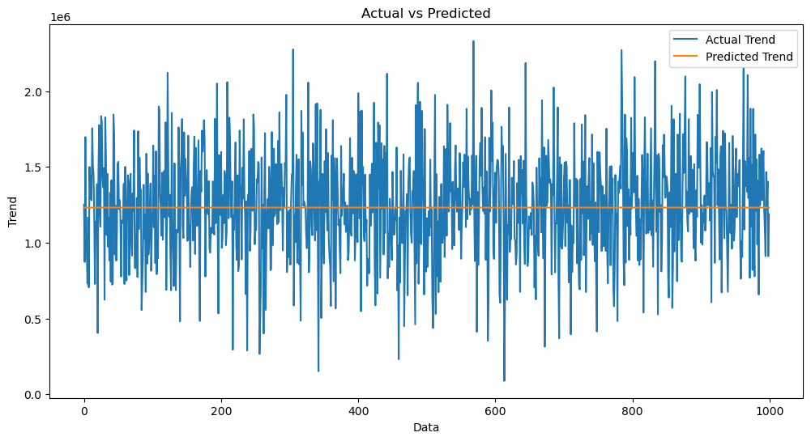
plt.plot(np.arange(Y_test)), Prediction2, label='Predicted Trend')
plt.xlabel('Data')
plt.ylabel('Trend')
plt.legend()
plt.title('Actual vs Predicted')
OUT[10]:
Text(0.5, 1.0, 'Actual vs Predicted')

Slide 12
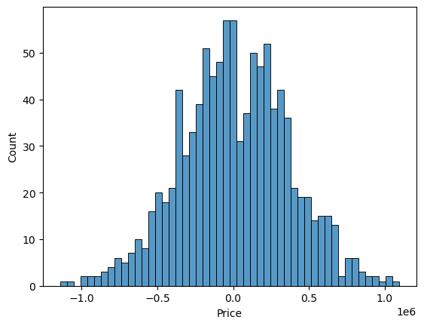
IN[11]:
sns.histplot((Y_test-Prediction2), bins=50)
OUT[12]:
<Axes: xlabel='Price', ylabel='Count'>

Slide 13
IN[12]:
print(r2_score(Y_test, Prediction2))
print(mean_absolute_error(Y_test, Prediction2))
print(mean_squared_error(Y_test, Prediction2))
--0.0006222175925689744
286137.81086908665
128209033251.4034
Model 3 - Lasso Regression
IN[13]
model_lar = Lasso(alpha=1)
IN[14]
model_lar.fit(X_train_scal,Y_train)
OUT[14]
Lasso
Lasso(alpha=1)
Predicting Prices
Prediction3 = model_lar.predict(X_test_scal)

Slide 14

Evaluation of Predicted Data
IN[16]:
plt.figure(figsize=(12,6))
plt.plot(np.arange(Y_test)), Y_test, label='Actual Trend')
plt.plot(np.arange((Y_test)), Prediction3, label='Predicted Trend')
plt.xlabel('Data')
plt.ylabel('Trend')
plt.legend()
plt.title('Actual vs Predicted')
OUT[16]:
Text(0.5, 1.0, 'Actual vs Predicted')

Slide 15
IN[17]: sns.histplot((Y_test-Prediction3), bins=50)
OUT[17]:
sns.histplot((Y_test-Prediction3), bins=50)
In[18]:
print(r2_score(Y_test, Prediction2))
print(mean_absolute_error(Y_test, Prediction2))
print(mean_squared_error(Y_test, Prediction2))
-0.0006222175925689744
286137.81086908665
128209033251.4034

Slide 16
Conclusion and Future Work(Phase 2):
Project Conclusion:
In the phase 2 conclusion,we will summarize the key findings and inside from the
Advanced regression techniques.we will reiterate the impact of these techniques
On improving the accuracy and robustness of house price prediction.
Future work:we will discuss potential avenues for future work such asincorporating
Additional data sources(eg.,real-time economic indicators),exploring deep learning models for prediction or expanding the project into a web application
With more features and interactivity.

